Slide 1
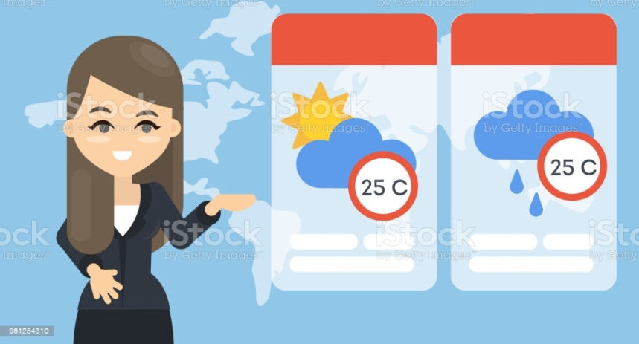
«Арқалық қаласы әкімдігінің қалалық тілдерді оқыту орталығы» КММ
Lesson 1
Groups: Pre – Intermediate .
Тhe theme: Describing the weather
Ағылшын тілінің оқытушысы : Гүлнұр Молдабаева

Slide 2
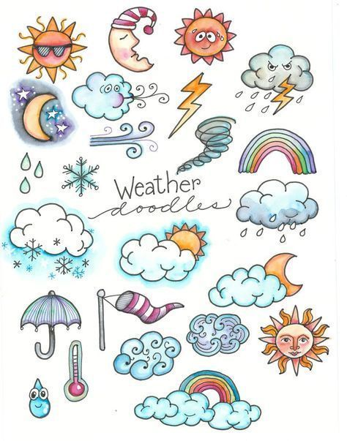
The 10 th of February
Today is Thursday
Theme: Describing the weather

Slide 3
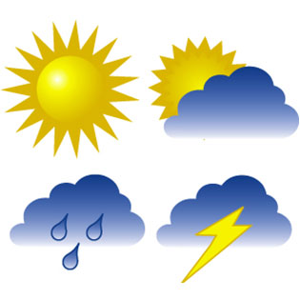
What is the weather like today?
Шуақты
sunny
Бұлтты-Cloudy
Суық- coldly.
Жаңбырлы -rainy
Аяз-frostly

Slide 4
Vocabulary: season — время года spring — весна summer — лето autumn — осень winter — зима month — месяц cloudless — безоблачный, seaside — берег моря bright — яркий dark — темный thankful — благодарен

Slide 5
Рerforming tasks

Slide 11
Read and translate the dialogue
1 - Hello, Charles.
- Hello, Dick, lovely day, isn't it?
- Absolutely wonderful, nice and warm. What's the weather forecast for tomorrow? Do you know?
- Yes, it says it will be bright and sunny.
- How nice. Nice weather for outing.
- You are right.
2 - Oh, that's you Tony. What is it like outdoors?
- It seems to be clearing up.
- What do you mean by clearing up?
- A big improvement on what we've been having. Quite different from the forecast.
- They say we are in for snow. It's supposed to cloud over this afternoon.
- Let's hope it keeps fine for the weekend.

Slide 12
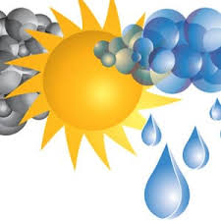
Conclusion:
Doing exercises.
Learn new words
Answer the following questions.

Slide 13
